Slide 1
BEARING DEFECT SIMULATION
BEARING SETUP:

Slide 2
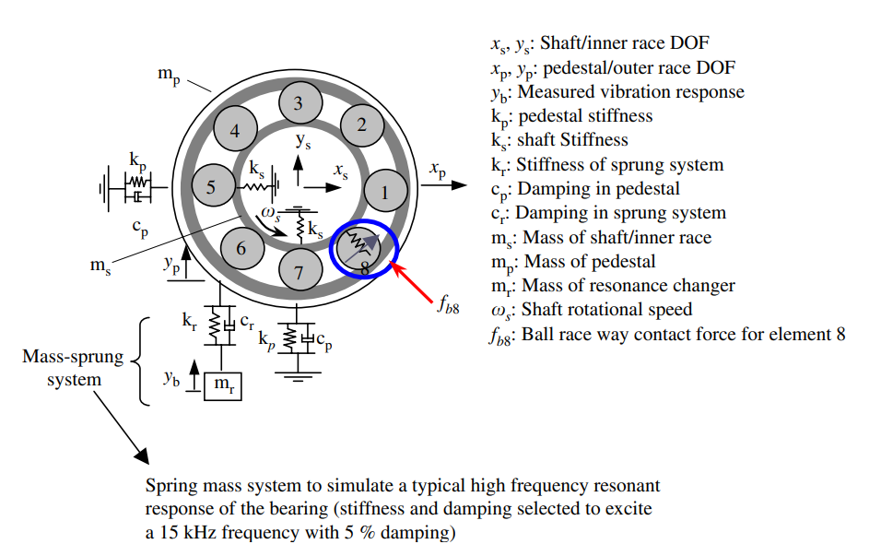
BEARING CHARACTERISTICS

Slide 3













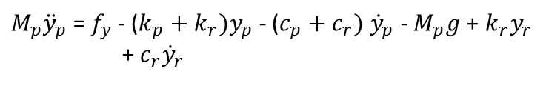






EQUATION OF MOTION
PEDESTAL:
Y – Direction : X – Direction:
$$k_{r}y_{r}$$
$$f_{y}$$
$$c_{r}{\dot{y}}_{r}$$
$$k_{p}x_{p}$$
Pedestal
Pedestal
$$y_{p}$$
$$c_{p}{\dot{x}}_{p}$$
$$f_{x}$$
$$M_{p}{\ddot{x}}_{p}$$
$$x_{p}$$
$$M_{p}{\ddot{y}}_{p}$$
$$k_{p}y_{p}$$
$$c_{p}{\dot{y}}_{p}$$
$$M_{p}g$$
$$k_{r}y_{p}$$
$$c_{r}{\dot{y}}_{p}$$
$f_{x}$ = $M_{p}{\ddot{x}}_{p}$ + $k_{p}x_{p}$ + $c_{p}{\dot{x}}_{p}$
$f_{y}$ = $M_{p}{\ddot{y}}_{p}$ + $k_{p}y_{p}$ + $c_{p}{\dot{y}}_{p}$ + $M_{p}g$ + $k_{r}y_{p}$ + $c_{r}{\dot{y}}_{p}$- $k_{r}y_{r}$- $c_{r}{\dot{y}}_{r}$
$M_{p}{\ddot{x}}_{p}$= $f_{x}$ - $k_{p}x_{p}$ - $c_{p}{\dot{x}}_{p}$
$f_{y}$ = $M_{p}{\ddot{y}}_{p}$ + ($k_{p}+k_{r})y_{p}$ + ($c_{p}+c_{r})$ ${\dot{y}}_{p}$ + $M_{p}g$ - $k_{r}y_{r}$- $c_{r}{\dot{y}}_{r}$
$M_{p}{\ddot{y}}_{p}$= $f_{y}$- ($k_{p}+k_{r})y_{p}$ - ($c_{p}+c_{r})$ ${\dot{y}}_{p}$ - $M_{p}g$+ $k_{r}y_{r}$ + $c_{r}{\dot{y}}_{r}$

Slide 4





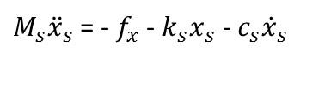







EQUATION OF MOTION
SHAFT /INNER RACE:
Y – Direction : X – Direction:
$$f_{y}$$
$$k_{s}x_{s}$$
Shaft
Shaft
$$y_{s}$$
$$c_{s}{\dot{x}}_{s}$$
$$f_{x}$$
$$M_{s}{\ddot{x}}_{s}$$
$$x_{s}$$
$$M_{s}{\ddot{y}}_{s}$$
$$k_{s}y_{p}$$
$$c_{s}{\dot{y}}_{s}$$
$$M_{s}g$$
${−f}_{y}$ = $M_{s}{\ddot{y}}_{s}$ + $k_{s}y_{s}$ + $c_{s}{\dot{y}}_{s}$ + $M_{s}g$
$−f_{x}$ = $M_{s}{\ddot{x}}_{s}$ + $k_{s}x_{s}$ + $c_{s}{\dot{x}}_{s}$
$M_{s}{\ddot{y}}_{s}$= ${−f}_{y}$- $k_{s}y_{s}$ - $c_{s}{\dot{y}}_{s}$ - $M_{s}g$
$M_{s}{\ddot{x}}_{s}$= - $f_{x}$ - $k_{s}x_{s}$ - $c_{s}{\dot{x}}_{s}$

Slide 5






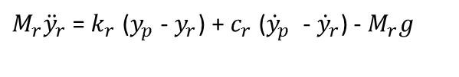

EQUATION OF MOTION
SPRUNG MASS:
Y – Direction :
$$k_{r}y_{p}$$
$$c_{r}{\dot{y}}_{p}$$
Mass
$$y_{r}$$
$$M_{r}{\ddot{y}}_{r}$$
$$k_{r}y_{r}$$
$$c_{r}{\dot{y}}_{r}$$
$$M_{r}g$$
$k_{r}y_{p}$ + $c_{r}{\dot{y}}_{p}$ = $M_{r}{\ddot{y}}_{r}$ + $k_{r}y_{r}$ + $c_{r}{\dot{y}}_{r}$ + $M_{r}g$
$M_{r}{\ddot{y}}_{r}$= $k_{r}$ ($y_{p}$ - $y_{r}$) + $c_{r}$ (${\dot{y}}_{p}$ - ${\dot{y}}_{r}$) - $M_{r}g$

Slide 6











EQUATION OF MOTION
Shaft
$$x_{s}$$
$$c_{s}$$
$$k_{s}$$
Inner Race
$$x_{i}$$
$$F_{x}$$
$$c_{i}$$
$$k_{i}$$
$$F_{x}$$
Outer Race
$$x_{o}$$
$$c_{o}$$
$$k_{o}$$

Slide 7

BEARING DEFORMATION EQUATION
5 – DOF DEFORMATION/DISPLACEMENT EQUATION:
Where,
$δ_{j}$ is deformation due to each ball
$φ_{j}$ is angular ball position
j is ball no.
Note:
Mass and inertia of rolling elements are ignored.
$$δ_{j}=(x_{s} −x_{P})\cos{φ_{j}}+(y_{s} −y_{p})\sin{φ_{j}}−Clearance$$

Slide 8
SIMULINK MODEL

Slide 9
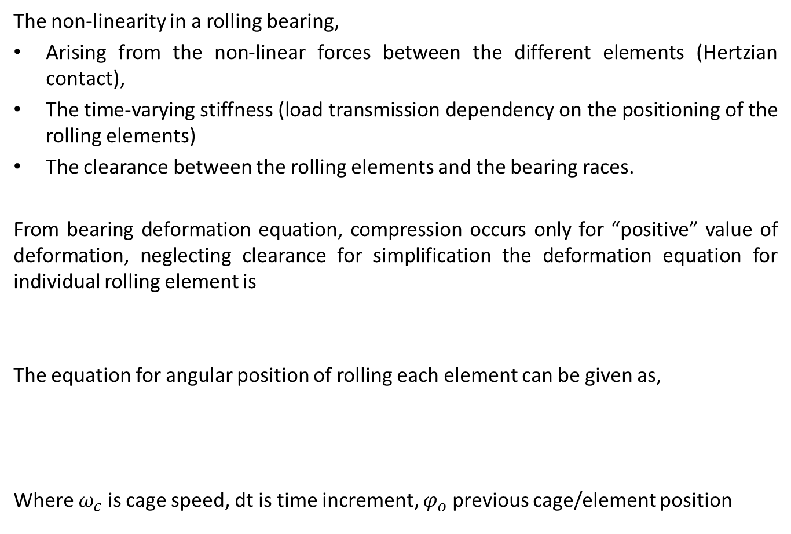
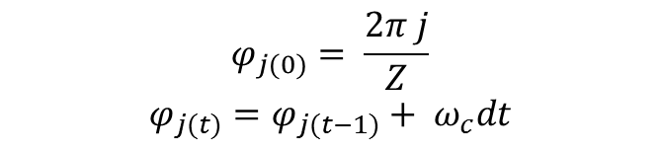

BEARING FORCE
The non-linearity in a rolling bearing,
Arising from the non-linear forces between the different elements (Hertzian contact),
The time-varying stiffness (load transmission dependency on the positioning of the rolling elements)
The clearance between the rolling elements and the bearing races.
From bearing deformation equation, compression occurs only for “positive” value of deformation, neglecting clearance for simplification the deformation equation for individual rolling element is
The equation for angular position of rolling each element can be given as,
Where $ω_{c}$ is cage speed, dt is time increment, $φ_{o}$ previous cage/element position
$$δ_{j}=(x_{s} −x_{P})\cos{φ_{j}}+(y_{s} −y_{p})\sin{φ_{j}}$$
$$φ_{j(0)}= \frac{2π j}{Z}$$
$${φ_{j(t)}=φ}_{j(t−1)}+ ω_{c}dt$$

Slide 10
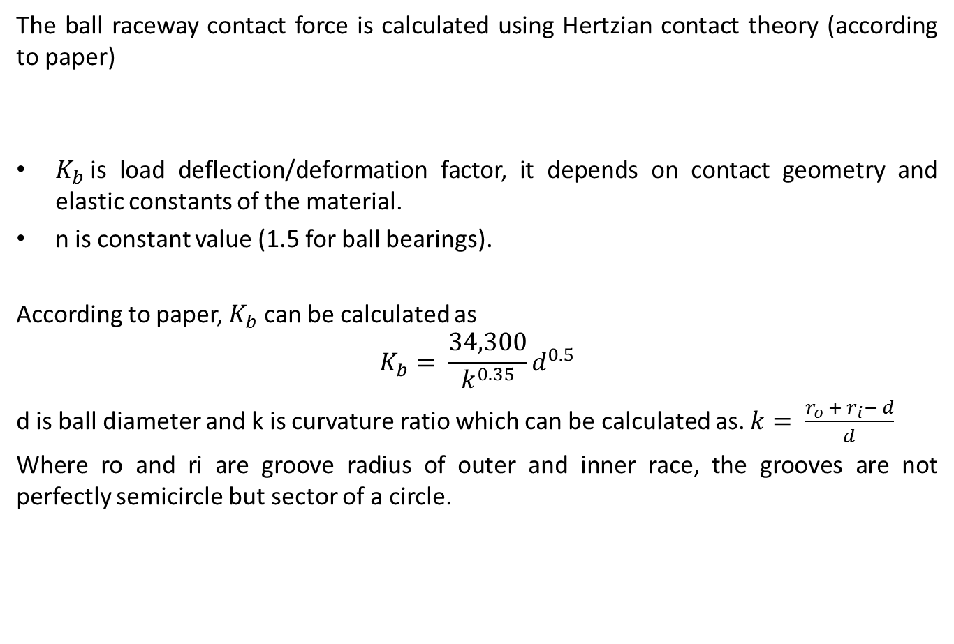

BEARING FORCE
The ball raceway contact force is calculated using Hertzian contact theory (according to paper)
$K_{b}$is load deflection/deformation factor, it depends on contact geometry and elastic constants of the material.
n is constant value (1.5 for ball bearings).
According to paper, $K_{b}$ can be calculated as
$$K_{b}= \frac{34,300}{k^{0.35}}d^{0.5}$$
d is ball diameter and k is curvature ratio which can be calculated as. $k= \frac{r_{o} + r_{i}− d}{d}$
Where ro and ri are groove radius of outer and inner race, the grooves are not perfectly semicircle but sector of a circle.
$$f=K_{b}×δ_{}^{n}$$

Slide 11

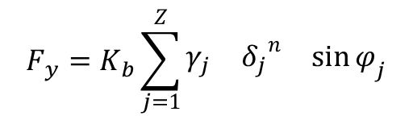
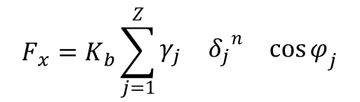
BEARING FORCE
Therefore the total bearing force calculated by summing forces of individual elements is.
Since the compression only occurs for positive value of $δ_{j}$, so
$$γ_{j}=\left\{\begin{matrix}1 & δ_{j}>0 \\ 0 & otherwise\end{matrix}\right.$$
$$F_{x}=K_{b}\sum_{j=1}^{Z}{\begin{matrix}γ_{j} & {δ_{j}}_{}^{n} & \cos{φ_{j}}\end{matrix}}$$
$$F_{y}=K_{b}\sum_{j=1}^{Z}{\begin{matrix}γ_{j} & {δ_{j}}_{}^{n} & \sin{φ_{j}}\end{matrix}}$$

Slide 12
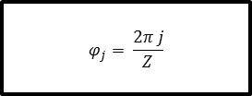
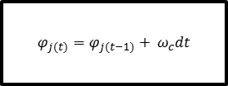
BALL POSITION FLOWCHART
start
Ball position algorithm
t < time
stop
no
Output from bearing force function
yes
t == 0
j< nb
$${φ_{j(t)}=φ}_{j(t−1)}+ ω_{c}dt$$
j = j +1
no
yes
yes
j< nb
t= t +1
no
Output fi_array
yes
$$φ_{j}= \frac{2π j}{Z}$$
j = j +1

Slide 13
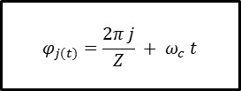
BALL POSITION FLOWCHART
start
t < time
yes
j < No. of balls (Z)
t= t +1
no
yes
$$φ_{j(t)}=\frac{2π j}{Z} + ω_{c} t$$
j = j +1

Slide 14
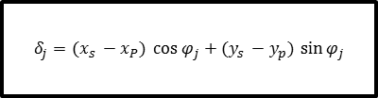
DELTA FUCTION FLOWCHART
Delta function algorithm
start
Output from ball position funtion, (xs – xp), (ys – yp)
no
j< nb
Output delta array
yes
$$δ_{j}=(x_{s} −x_{P})\cos{φ_{j}}+(y_{s} −y_{p})\sin{φ_{j}}$$
j = j +1

Slide 15
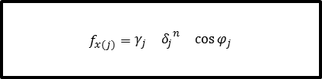
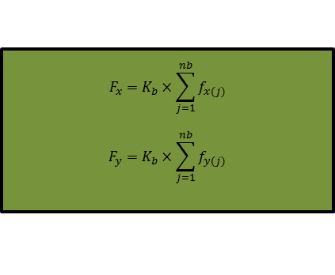

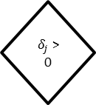
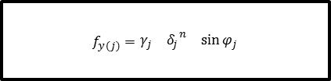
BEARING FORCE FLOWCHART
Bearing Force algorithm
start
Output from ball position funtion
$$F_{x}=K_{b}×\sum_{j=1}^{nb}{f_{x(j)}}$$
$$F_{y}=K_{b}×\sum_{j=1}^{nb}{f_{y(j)}}$$
Output from delta function
t = t + 1
j< nb
no
yes
$$f_{x(j)}=\begin{matrix}γ_{j} & {δ_{j}}_{}^{n} & \cos{φ_{j}}\end{matrix}$$
$δ_{j}$ > 0
yes
1
$$γ_{j}$$
$$f_{y(j)}=\begin{matrix}γ_{j} & {δ_{j}}_{}^{n} & \sin{φ_{j}}\end{matrix}$$
no
0
j = j +1

Slide 16
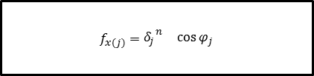
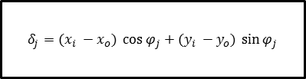
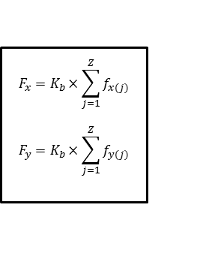


BEARING FORCE FLOWCHART
start
t < time
yes
Output from ball position at time = t
$$F_{x}=K_{b}×\sum_{j=1}^{Z}{f_{x(j)}}$$
$$F_{y}=K_{b}×\sum_{j=1}^{Z}{f_{y(j)}}$$
t = t + 1
j < Z
no
yes
$$f_{x(j)}=\begin{matrix}{δ_{j}}_{}^{n} & \cos{φ_{j}}\end{matrix}$$
$$δ_{j}=(x_{i} −x_{o})\cos{φ_{j}}+(y_{i} −y_{o})\sin{φ_{j}}$$
$δ_{j}$ > 0
yes
j = j +1
$$f_{y(j)}=\begin{matrix}{δ_{j}}_{}^{n} & \sin{φ_{j}}\end{matrix}$$
no

